Slide 1

Quantum Computing: Introduction

Slide 2
Why Do We Have Computers?

Slide 3
Why Do We Do Computing?

Slide 4
Answer
To Solve Problems

Slide 5
Answer Reworded
To Gain Insight
.

Slide 6
Answer Extended
To Enable
a Better Life & Future

Slide 7
How Does a Computer Solve Problems?

Slide 8
Answer
Orchestrating Electrons

Slide 9
How Do Problems Get Solved by Electrons?

Slide 10
The Transformation Hierarchy
Problem
Algorithm
Program/Language
System Software
Computer Architecture (expanded view)
SW/HW Interface
Computer Architecture (narrow view)
Micro-architecture
Logic
Devices
Electrons

Slide 11
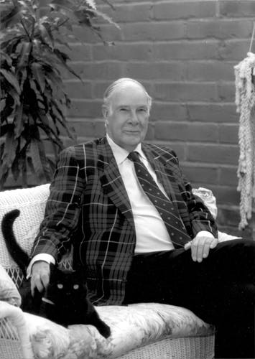
Levels of Transformation
“The purpose of computing is [to gain] insight” (Richard Hamming)
We gain and generate insight by solving problems
How do we ensure problems are solved by electrons?
Algorithm
Step-by-step procedure that is guaranteed to terminate where each step is precisely stated and can be carried out by a computer
Finiteness
Definiteness
Effective computability
Many algorithms for the same
problem
Problem
Algorithm
Program/Language
Runtime System
(VM, OS, MM)
ISA
(Instruction Set Architecture)
Interface/contract between SW and HW.
What the programmer assumes hardware will satisfy.
ISA (Architecture)
Microarchitecture
Logic
Devices
Electrons
Microarchitecture
An implementation of the ISA
Digital logic circuits
Building blocks of micro-arch (e.g., gates)

Slide 12
Conventional Physics:
Continuous Variables: Conventional physics deals with continuous variables, where properties like position, velocity, and energy can take on any value within a given range
No Superposition: Classical objects have definite properties; they cannot exist in multiple states simultaneously
No Entanglement 无纠缠: Classical objects do not exhibit entanglement, where the properties of one object are correlated with the properties of another, even when separated by large distances
Determinism: Conventional physics, based on classical mechanics and electromagnetism, operates on deterministic principles

Slide 13
Quantum Physics
Probabilistic Nature: Quantum physics, based on principles such as superposition and wave-particle duality, is inherently probabilistic
Discrete States: Quantum systems have discrete states and quantized properties
Superposition: Quantum objects can exist in superposition, meaning they can be in multiple states simultaneously until measured
Entanglement: Quantum systems can exhibit entanglement, where the properties of entangled particles are correlated regardless of the distance between them

Slide 14

Conventional Computation v/s Quantum Computation

Slide 15
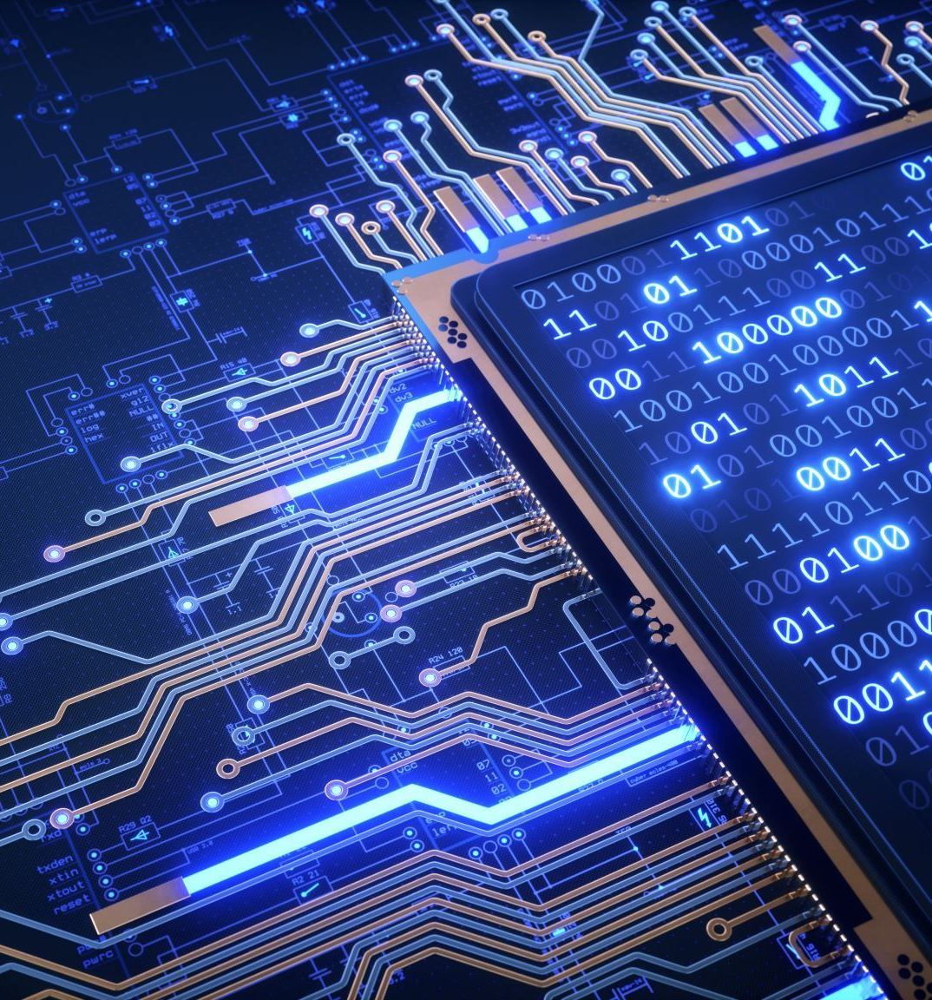
Conventional Computation
Binary Representation: Conventional computers use binary digits as the fundamental unit of information
Deterministic Logic: Conventional computing operates on deterministic logic, where the outcome of each operation is precisely determined by the input and the logic gates applied
Sequential Processing: Conventional computers process information sequentially, executing one instruction at a time
Classical Physics: Conventional computing is based on classical physics principles

Slide 16
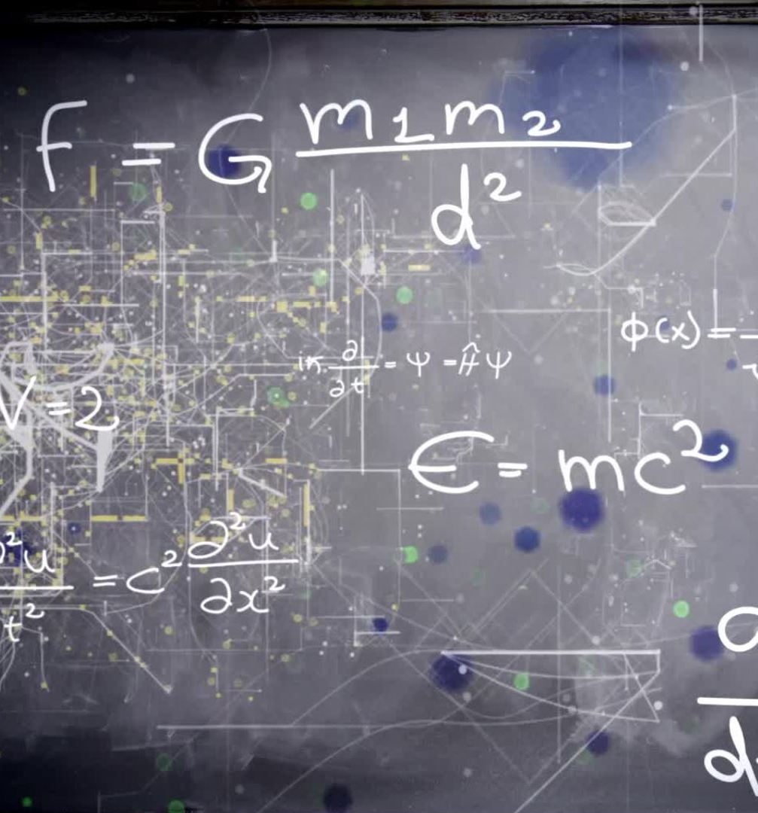
Quantum Computation
Qubit Representation: Quantum computers use quantum bits as the fundamental unit of information
Probabilistic Logic: Quantum computing operates on probabilistic logic due to the inherent uncertainty of quantum states
Parallel Processing: Quantum computers can process information in parallel due to superposition and entanglement
Quantum Mechanics: Quantum computing is based on the principles of quantum mechanics, including concepts such as superposition, entanglement, and interference
Notes:
It's not sure that it will pass through same slit.

Slide 17

Conventional Computing Stack v/s Quantum Computing Stack

Slide 18
Conventional Computing Stack
Memory: Random Access Memory (RAM) for temporary storage of data and instructions.
Storage: Hard Disk Drive (HDD) or Solid-State Drive (SSD) for long-term storage of data.
1. Hardware Layer:
Processor: Central Processing Unit (CPU) or Graphics Processing Unit (GPU) containing billions of transistors.

Slide 19
2. Software Layer
Applications: Programs developed for specific tasks
Quantum Processor: Quantum bits implemented using physical systems such as superconducting circuits, trapped ions, or photonic systems
Quantum Memory: Temporary storage of quantum information required for quantum algorithms and operations

Slide 20
Quantum Computing Stack:
1. Hardware Layer:
Quantum Processor: Quantum bits (qubits) implemented using physical systems such as superconducting circuits, trapped ions, or photonic systems.
Quantum Memory: Temporary storage of quantum information required for quantum algorithms and operations.
Classical Control Systems: Classical computers are used to control and read out the state of quantum systems.
2. Software Layer:
Quantum Programming Languages: High-level languages tailored for expressing quantum algorithms (e.g., Qiskit, Cirq).
Quantum Circuit Design Tools: Software for designing and simulating quantum circuits (e.g., IBM Quantum Composer, Quirk).
Quantum Algorithms and Libraries: Implementations of quantum algorithms (e.g., Shor's algorithm, Grover's algorithm) and libraries for quantum simulation and optimization.
Classical-Quantum Interface: Software for interfacing between classical control systems and quantum processors, handling tasks such as error correction, noise mitigation, and measurement.

Slide 21
Quantum Computer Applications
1. Factoring large integers:
2. Searching unsorted databases:
3. Simulating quantum systems:
4. Optimization problems:
5. Machine learning and AI:

Slide 22
How to physically generate Qubits?
Quantum bits, or qubits, are the fundamental units of quantum information, analogous to classical bits
Unlike classical bits, which can be either 0 or 1, qubits can exist in a superposition of both 0 and 1 simultaneously, allowing for the potential for exponentially more computational power in quantum computers
There are various physical systems that can be used to implement qubits, each with its own method of generation

Slide 23

How to physically generate Qubits?
1. Superconducting Qubits:
2. Trapped Ions:
3. Quantum Dots:
4. Neutral Atoms:
5. Nuclear Magnetic Resonance (NMR):

Slide 24

Qubit Generation using light photon

Slide 25
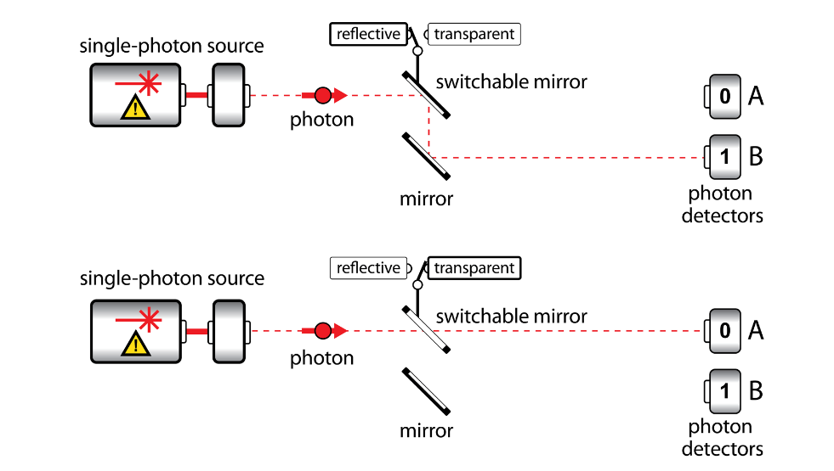
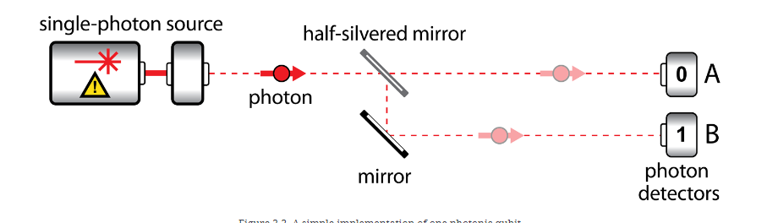
Qubit Generation using light photon

Slide 26
Wave-Particle Duality
This wave-particle duality is a fundamental aspect of quantum mechanics, where particles exhibit both wave-like and particle-like behavior depending on the experimental setup
The Young's double-slit experiment beautifully demonstrates this duality and provides insight into the mysterious nature of quantum particles
Wave-particle duality is a fundamental concept in quantum mechanics that describes the dual nature of particles, such as electrons and photons

Slide 27

Young's double-slit experiment
The double-slit experiment demonstrates that particles, such as electrons or photons, can exhibit wave-like interference patterns when passing through two slits, even when sent through one at a time
The Young's double-slit experiment is a classic demonstration of the wave-like nature of light and other quantum particles
It was first performed by Thomas Young in 1801 and remains one of the most fundamental experiments in the history of physics
Notes:
Super position

Slide 28
Here's a simplified explanation of the experiment
Imagine you have a screen with two small slits close to each other
When light from the source passes through the slits, it creates two separate waves that propagate outward
This interference pattern arises because the waves from the two slits interfere with each other, creating regions of constructive and destructive interference
In the double-slit experiment, even when we reduce the intensity of the light source so much that only one photon passes through the apparatus at a time, the interference pattern still emerges over time as individual photons hit the screen

